Slide 1
Travel behavior differences between Arab and Jewish communities in Israel
Diana Saadi and Karel Martens
Faculty of Architecture and Town Planning
The Fair Transport Lab
The Fair Transport Lab July 14

Slide 2
Multiple studies show that ethnic minorities exhibit travel behavior patterns that differ from majority populations.

Slide 3
What is the gap?

Slide 4
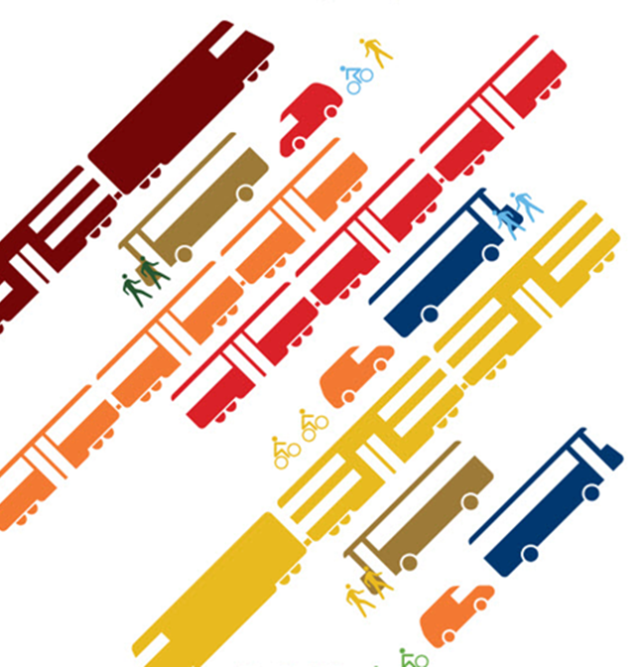
The unique case of Israel

Slide 5
The purpose
Investigate differences in travel behavior between three groups:
Arabs who live in Arab settlements
Jews who live in Jewish settlements
Arabs who live in Jewish settlements

Slide 6
What is the question?
Does the travel behavior of Arabs who moved to Jewish town resembles the behavior of other Arabs or of their Jewish counterparts?

Slide 7
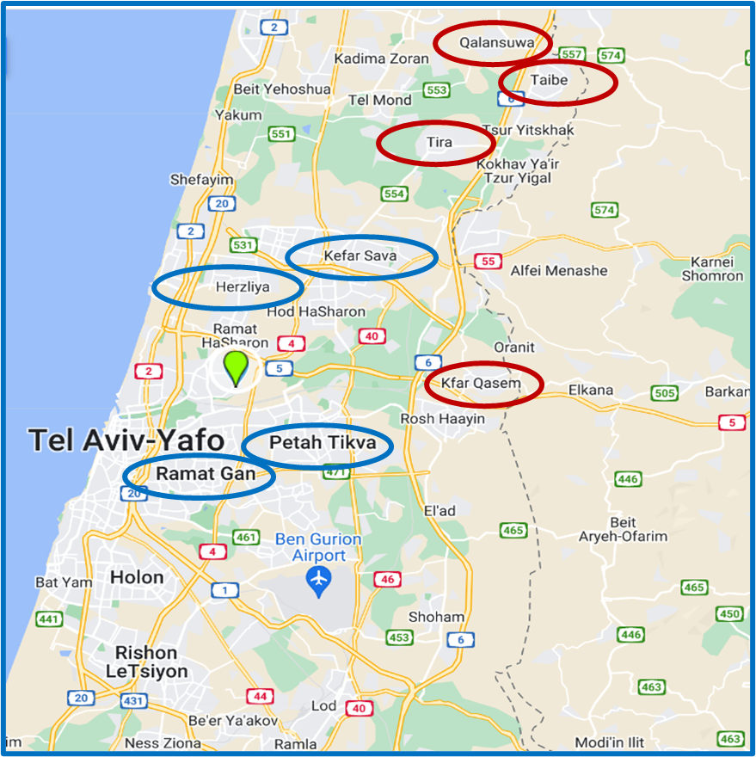
Data
Large-scale GPS-based travel behavior survey
Cities, towns and settlements in Tel Aviv region
Households
Respondents
Trips

Slide 8
Ethnicity
Arab / Jewish
socio-demographic variables.
Age- Gender- Education- Occupation-Number of children per household-Household size- Household composition
residential location
Arab settlement / Jewish settlement/ Mixed city
Travel Behavior
Notes:
Independent variables: ethnicity (Arab-Jewish), place of residence (Arab settlement or Jewish settlement), socioeconomic status(Socio-demographic characteristics included variables often identified in the literature as associated with changes in travel behaviors and crash involvement: gender, marital status and occupational status)
Dependent variables: mobility behavior which include the following variables:
Accompanying travelers - Travel time - number of passengers - trip duration - trip distance- Activity

Slide 9
Total daily trip distance by group and gender (in km)

Slide 10
Daily trips duration of the groups by gender differences(minutes)

Slide 11
The distance to work by group and gender

Slide 12
Total daily trip duration to work by group and gender (in minutes)

Slide 13
The means of travel to work

Slide 14
The number of vehicles in each household

Slide 15
Travel Motives

Slide 16
The average number of passengers (without the driver) Jews and Arabs from different communities by gender

Slide 17
Accompanying travelers - Jews and Arabs from different communities by gender

Slide 18
Travel time - Jews and Arabs from different communities by gender
 | Male |  |  | Female
 | Jewish in Jewish com' | Arabs in Arabs com' | Arabs in Jewish com' | Jewish in Jewish com' | Arabs in Arabs com' | Arabs in Jewish com'
Start of the day | 17.66% | 21.75% | 17.76% | 18.37% | 22.56% | 18.35%
During the day | 62.54% | 50.95% | 62.72% | 60.95% | 48.12% | 61.69%
End of the day | 17.66% | 21.75% | 17.76% | 18.37% | 22.56% | 18.35%
No travel | 2.14% | 5.56% | 1.77% | 2.32% | 6.76% | 1.61%

Slide 19
Arabs in Jewish towns are somewhat closer to Jews than to Arabs in Arab towns in the travel behaviors indicators:
Total daily trip distance
The distance to work
The means of travel to work
Travel Motives
The average number of passengers
Accompanying travelers

Slide 20
The Arab group in the Jewish cities is like the Arab group in the Arab cities in terms of the gender difference in the same group and in the travel behavior indicator of the average number of passengers.
The travel behavior of Arabs who live in Arab cities is distinctly different from the travel behavior of Jews who live in Jewish cities In terms of all the elements of our travel behavior in the study, Except for the Accompanying traveler's element.
There is a difference between Arab women who live in Arab cities and Jewish and Arab women who live in Jewish cities in terms of all the elements of our travel behavior in the study.

Slide 21
Conclusion
Taken together, the results suggests that Arabs living in Jewish settlements adopt the travel behavior of their local peers. This may be the result of assimilation in the majority population, but it may also be a result of self-selection, with Arabs who are less rooted in kinship relations.

Slide 22
What can explain what we have found
Arabs living in Jewish settlements adopt the travel behavior of their local peers
Self-selection
Assimilation

